Slide 1
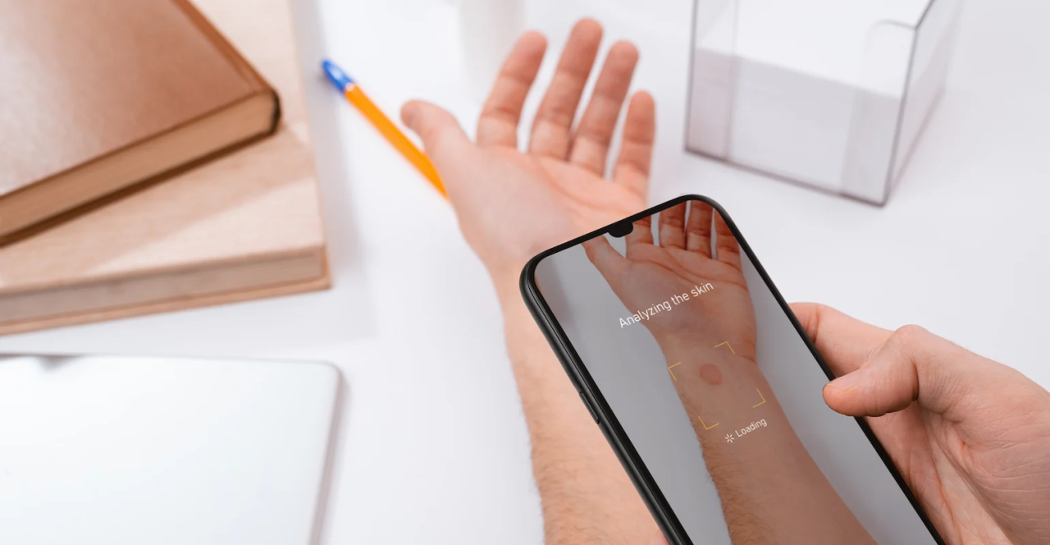

Deep-Lesion Scan
A Soft Attention-enhanced ResNet Model For Multi-class Dermoscopic Image Diagnosis
Prepared by :
Danya Imran
Norah Alhusaini
Shaima Alwahas
For ICS 504 - Deep Learning - Dr. Muzammil Behzad
Notes:
Welcome everyone. Today, we’re presenting our deep learning research project: Deep-Lesion Scan. This study aims to enhance skin lesion classification by integrating a Soft Attention mechanism into the ResNet50 architecture to improve both accuracy and interpretability.

Slide 2
Agenda
Introduction
Research Objectives
Literature Review
Problem Statement
Dataset & Preprocessing
Methodology
Evaluation & Results
Grad-cam Visualization
Future Work
Notes:
Welcome everyone. Today, we’re presenting our deep learning research project: Deep-Lesion Scan. This study aims to enhance skin lesion classification by integrating a Soft Attention mechanism into the ResNet50 architecture to improve both accuracy and interpretability.

Slide 3
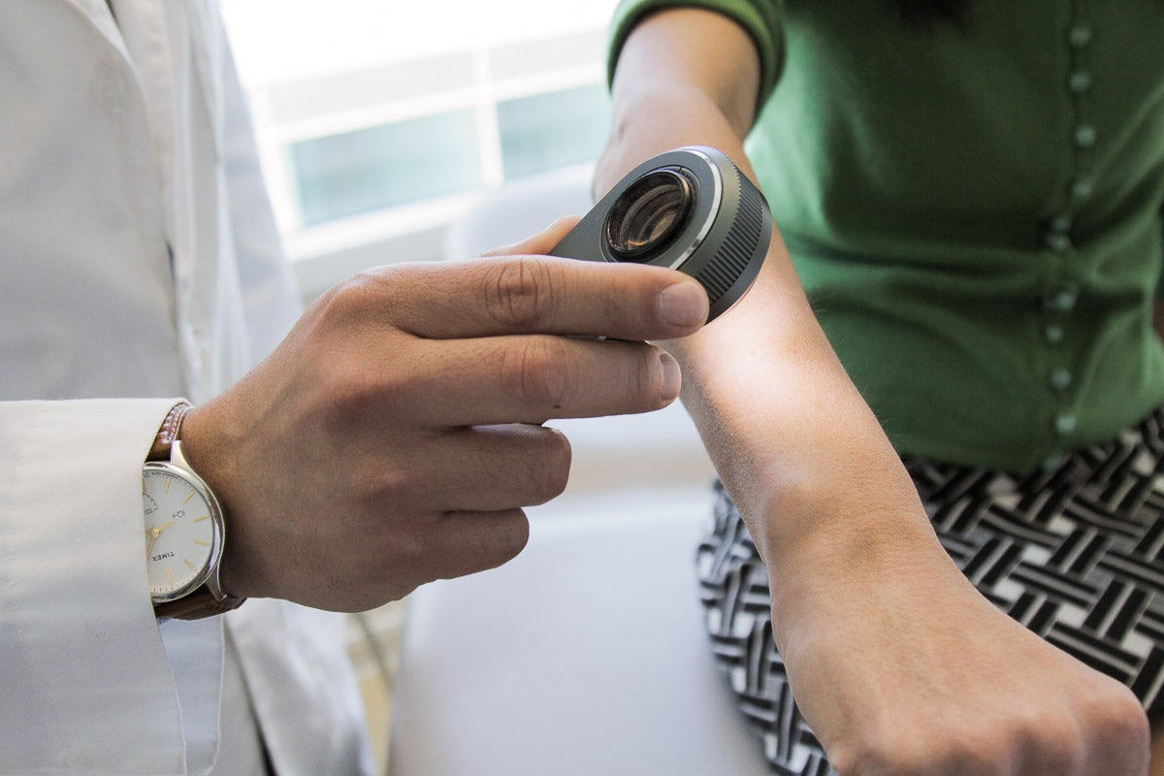


Introduction
Skin cancer is one of the most common cancers globally
1 in 5 people will develop it in their lifetime
Early diagnosis is critical—melanoma can become deadly in 6 weeks
Current CNNs lack spatial focus and interpretability
Leveraging AI and deep learning can lead to faster, more consistent, and scalable diagnosis.
Notes:
Skin cancer is a major global health issue—1 in 5 people are expected to develop it in their lifetime.
Early diagnosis is critical, especially for melanoma, which can become dangerous in just a few weeks.
Current CNN models like ResNet50 are strong, but they treat all image regions equally and work as “black boxes”—lacking focus and transparency.
Our research aims to address these limitations by adding Soft Attention to ResNet50, making it more accurate and more interpretable for medical use.

Slide 4
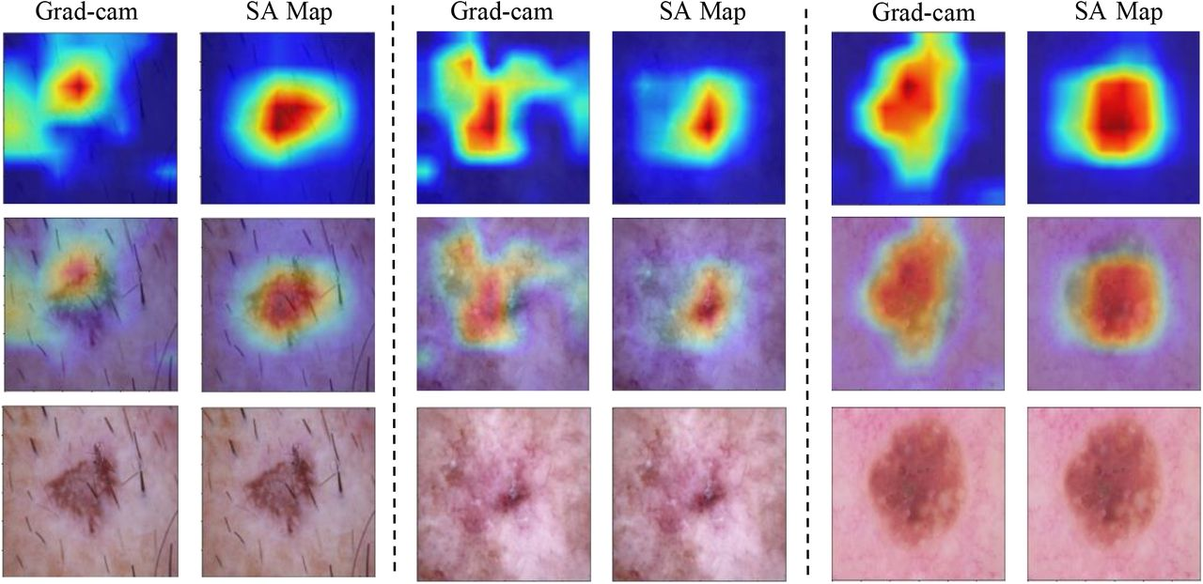
Research Objectives
Develop an accurate and interpretable model using HAM10000 dataset
Integrate a Soft Attention mechanism into ResNet50
Address class imbalance and noise in dermoscopic data
Evaluate performance with accuracy, F1-score, ROC-AUC
Provide visual interpretability with Grad-cam
Notes:
Our primary goal was to create a model that classifies skin lesions accurately and transparently.
We had four key objectives:
Enhance ResNet50 with Soft Attention.
Handle class imbalance through data augmentation and preprocessing.
Improve generalization using regularization, early stopping, and fine-tuning.
Evaluate performance with metrics like accuracy, precision, F1-score, and ROC-AUC, along with visual tools like gradcam heatmaps.

Slide 5
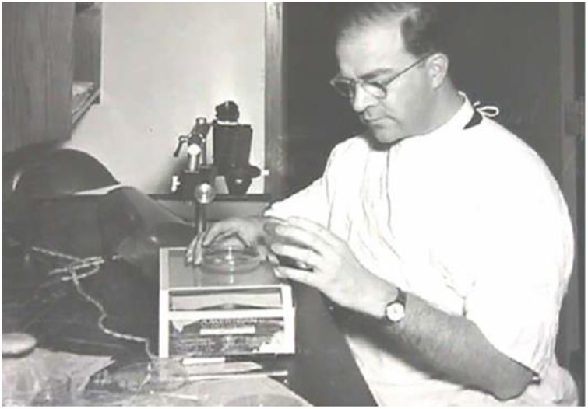
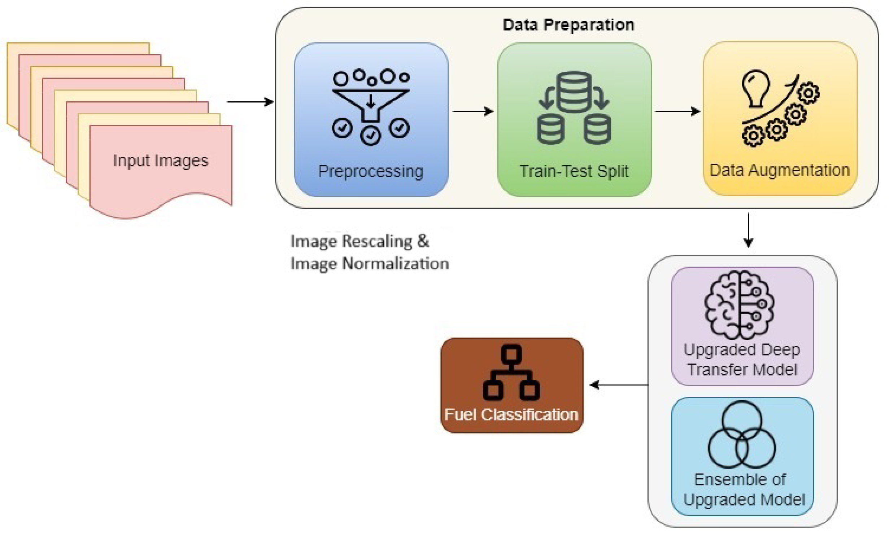

Literature Review
Traditional Approaches in Dermatological Image Analysis
Advancements with Deep Learning Models
Challenges in Dermatology Image Analysis
Traditionally, dermatologists relied on manual image analysis or classical machine learning with handcrafted features.
Deep learning models like ResNet, VGG16, DenseNet, and InceptionResNetV2 improved performance through transfer learning.
Challenges such as class imbalance, image noise, and low inter-class variance still limit performance.
Notes:
-researchers or practitioners had to manually design and extract relevant features from images (such as color, texture, or shape of skin lesions) before applying machine learning algorithms.

Slide 6
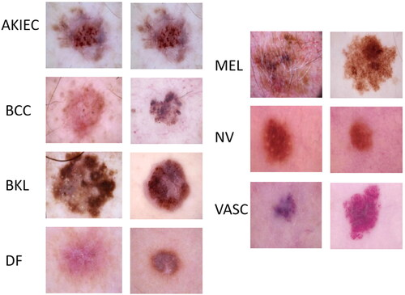
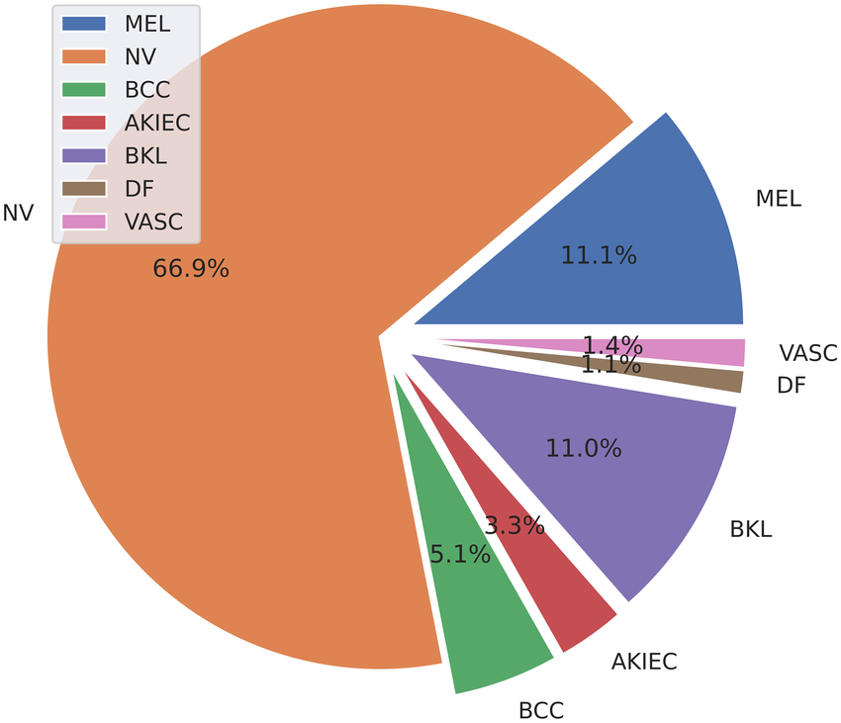
Problem Statement
Generalization Across Similar Lesions
Class Imbalance in Skin Lesion Datasets
Many skin lesions share overlapping features, making it difficult for deep learning models to distinguish between classes. Improving generalization is essential to handle such low inter-class variance effectively.
Many dermatology datasets, including HAM10000, suffer from class imbalance, where common lesion types dominate the dataset while rare but critical classes like melanoma (MEL) and dermatofibroma (DF) have very few samples.

Slide 7
Dataset & Preprocessing
Dataset: HAM10000 (10,015 images, 7 lesion classes)
Major class imbalance (e.g., 67% are nevi)
Class Distribution in the HAM10000 Dataset :
Class Label | Abbreviation | Number of Images | Percentage (%)
Melanocytic nevi | NV | 6,705 | 66.9%
Melanoma | MEL | 1,113 | 11.1%
Benign keratosis-like lesions | BKL | 1,099 | 11.0%
Basal cell carcinoma | BCC | 514 | 5.1%
Actinic keratoses | AKIEC | 327 | 3.3%
Vascular lesions | VASC | 142 | 1.4%
Dermatofibroma | DF | 115 | 1.1%
Total |  | 10,015 | 100%
Notes:
Our model is based on ResNet50 with a Soft Attention module inserted before the global pooling layer.
The attention module helps the network focus on lesion regions—such as borders and color variation—by assigning different weights across spatial features.
We used label smoothing, L2 regularization, and a two-phase training strategy to enhance generalization.
Dataset & Preprocessing
We used the HAM10000 dataset with over 10,000 dermoscopic images across seven lesion classes.
The data is highly imbalanced—most images are nevi.
So we applied class-wise augmentation to ensure each class had around 2,000 samples.
Images were resized and normalized, and we used random flips, rotations, and brightness shifts to improve robustness.

Slide 8
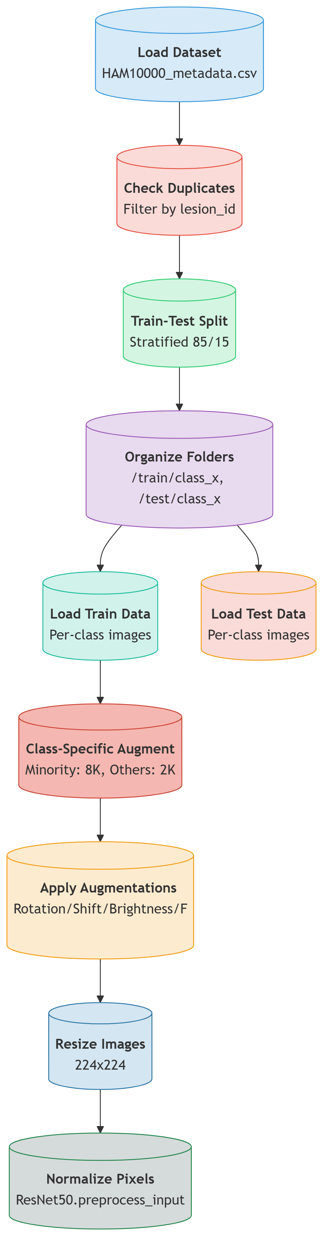
Data Preprocessing & Augmentation
Load & Clean Data:
Remove duplicate images to avoid bias in training.
Augment Minority Classes:
-Generate extra images for rare classes using rotations, flips, and brightness changes. This balances the dataset and improves model accuracy.
-For underperforming classes (mel, df, akiec, bcc), 8,000 augmented images are generated, while others receive 2,000.
Resize & Normalize:
Resize all images to 224x224 pixels (standard for models like ResNet50).

Slide 9
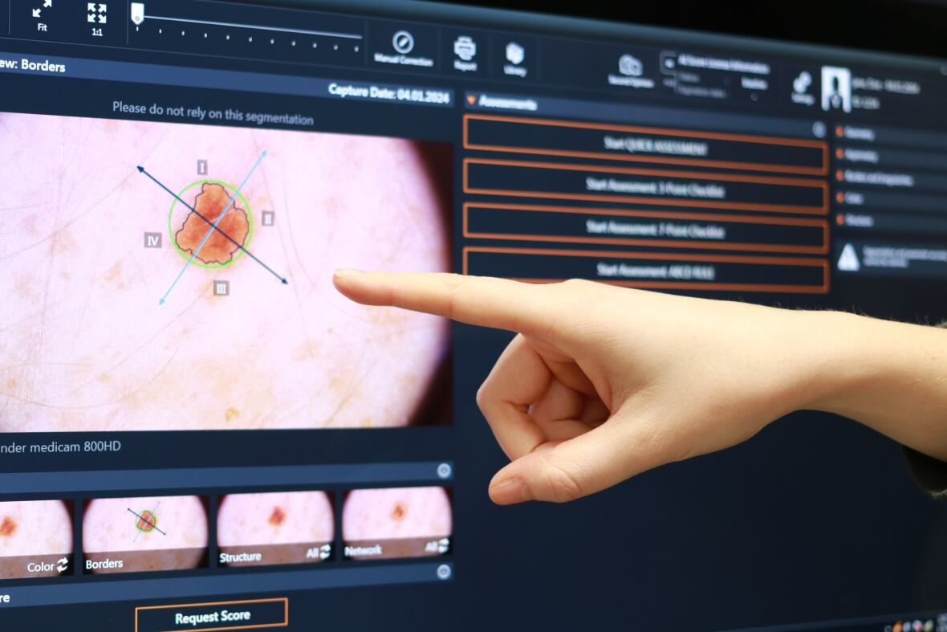
Methodology

Slide 10
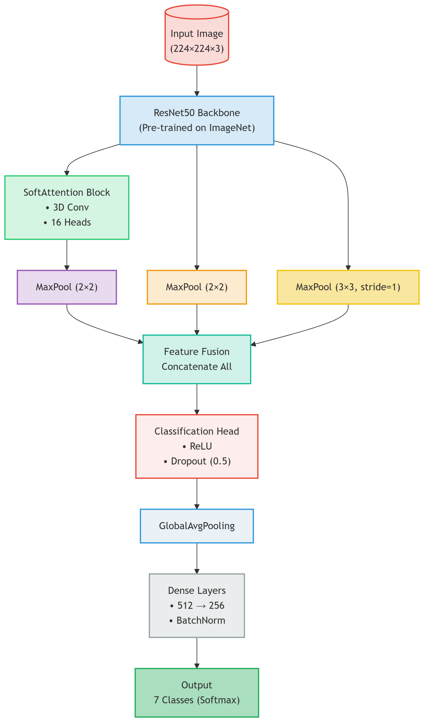
Model Architecture
ResNet50 Backbone – Pre-trained on ImageNet for robust feature extraction.
Soft Attention Block – Uses 3D Conv + 16 attention heads to highlight important regions.
Multi-Scale Pooling – Combines:
Standard 2×2 MaxPool
Wider 3×3 MaxPool (stride=1) for context
Feature Fusion – Concatenates attention-weighted and pooled features.
Regularization-Heavy Head – Includes:
Dropout (0.5), BatchNorm, Label Smoothing
Optimized Training – Adam (LR=1e-4) with L2 regularization.
Output – 7-class softmax prediction.
Notes:
This architecture enhances a pre-trained ResNet50 backbone with a multi-head soft attention mechanism to focus on salient image regions. The model processes features through three parallel pathways: (1) an attention branch using 3D convolutions and 16 attention heads, followed by 2×2 max pooling; (2) a main path with standard 2×2 pooling; and (3) a context path with 3×3 pooling (stride=1) to preserve spatial information. These streams merge via concatenation, combining attended features with multi-scale representations. The fused features pass through a robust classification head featuring heavy regularization (0.5 dropout, label smoothing, L2 penalties) and batch normalization across two dense layers (512→256 units). Ultimately, the model outputs class probabilities via softmax, leveraging both attention-driven localization and hierarchical feature learning while mitigating overfitting through systematic regularization. The entire system is optimized with Adam (LR=1e-4) for balanced convergence.

Slide 11
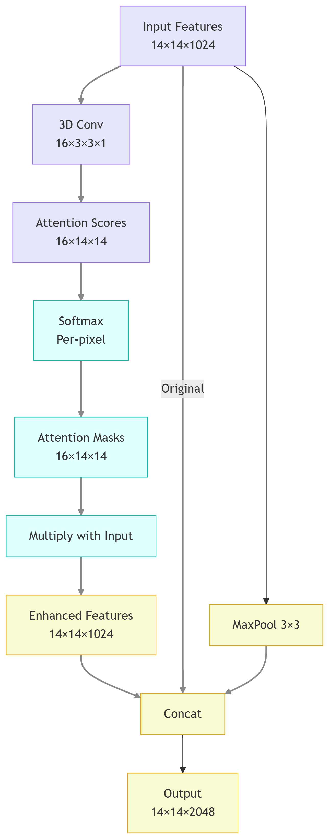
Soft Attention
- Input: Feature maps (14×14×1024) - 3D Conv: Generates 16 attention heads (kernel=3×3×1) - Scoring: Produces 16×14×14 attention scores - Softmax: Normalizes scores per-pixel → attention masks - Feature Enhancement: Masks × input features → 14×14×1024 - Multi-Scale Fusion: Concatenates: Enhanced features, original features and MaxPool (3×3) features - Output: Enriched 14×14×2048 feature maps
Notes:
The Photo (Input)
You start with a detailed 14×14 grid photo that highlights 1,024 important clues (like colors, edges, objects).
Your Magnifying Glasses (3D Convolution)
You use 16 special magnifying glasses (attention heads) that each focus on different 3×3 areas of the photo to spot subtle patterns.
Suspect Highlighting (Attention Scores)
Each magnifying glass assigns "suspect scores" to every spot on the photo (16 sets of 14×14 scores) showing where to look closer.
Prioritizing Clues (Softmax)
You compare all scores and highlight only the most important spots in red (like heat maps), dimming less important areas.
Zooming In (Multiply)
You now examine only the red-highlighted areas in full detail, making the important clues clearer (enhanced 14×14×1024 features).
Combining Evidence (Concatenate)
You merge:
The zoomed-in clues
The original full photo
A blurred version (3×3 maxpool) to see the big picture Result: A super-complete 14×14×2048 evidence board!

Slide 12
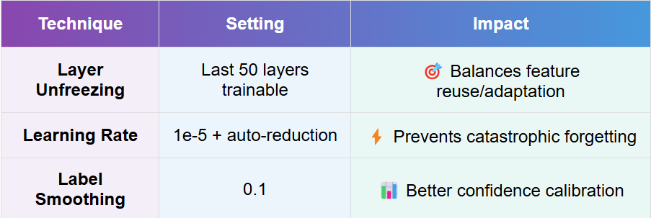
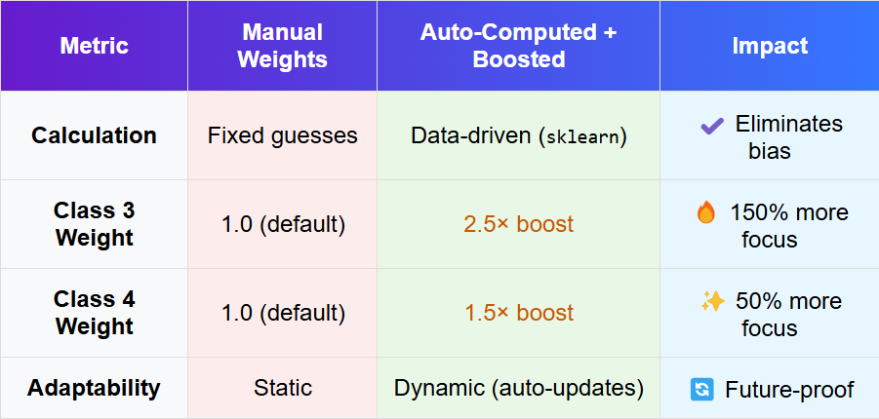
Optimized Training Strategies
Fine-tuning the model
Smart Class Weighting
Partial unfreezing of ResNet50’s last 50 layers with low LR (1e-5) and label smoothing (0.1) refined feature adaptation without overfitting
Automated class balancing with strategic 2.5×/1.5× boosts for critical classes improved the overall precision, while preventing majority class dominance

Slide 13
EVALUATION & RESULTS

Slide 14
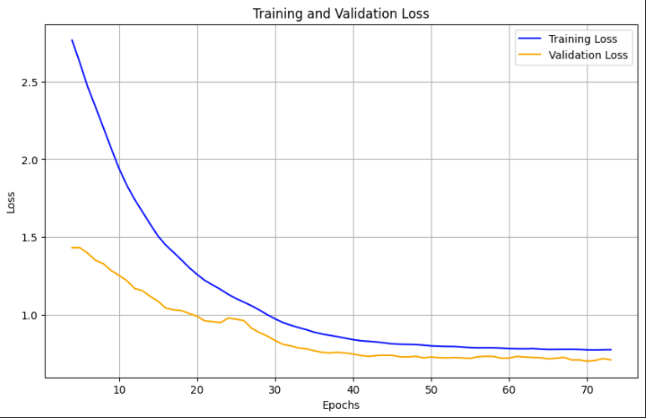
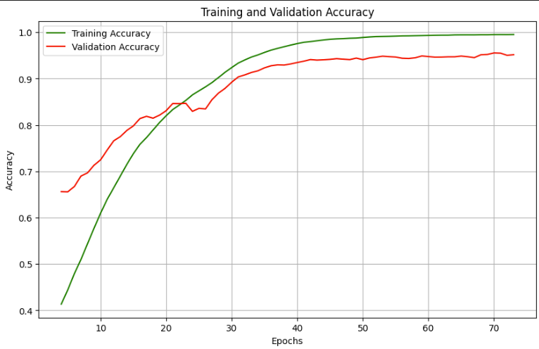
Model Learning Curves
Loss Graph
Accuracy Graph

Slide 15
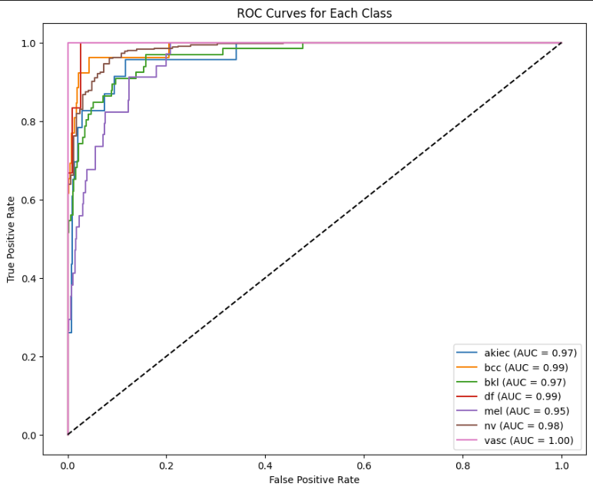
ROC Curves for Each class
Class-wise ROC curves for the proposed model. The area under each curve (AUC) reflects the model’s ability to differentiate between classes. Most classes achieve an AUC above 0.95, indicating strong discriminatory performance.

Slide 16
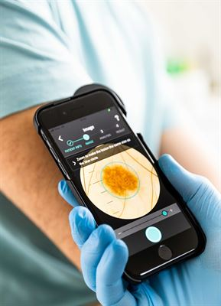
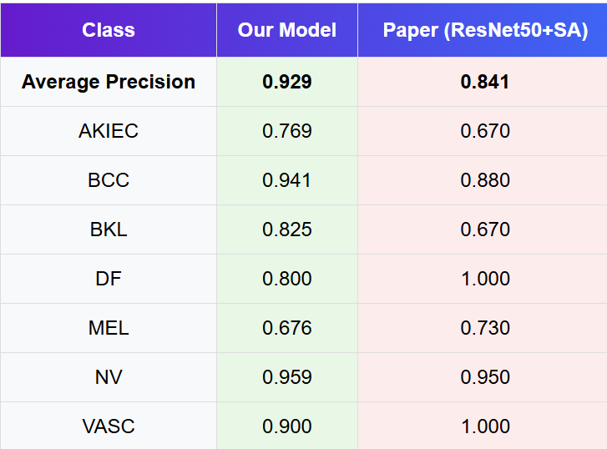
Model Results Comparison Breakdown by Class

Slide 17
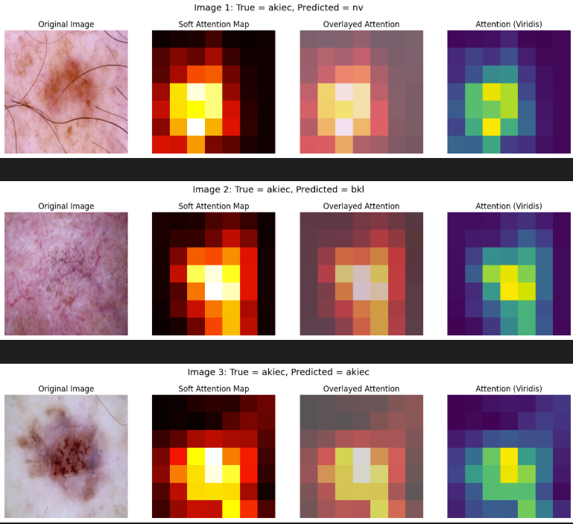
Attention Maps
These visualizations compare the model’s attention patterns against original skin lesion images, alongside their true and predicted diagnoses.
When the model misclassifies (e.g., AKIEC predicted as NV/BKL), the attention often focuses on irrelevant regions like healthy skin or shadows.
Correct predictions (e.g., AKIEC→AKIEC) show concentrated attention on diagnostically critical features like lesion borders or color variations.
Notes:
When the model misclassifies (e.g., AKIEC predicted as NV/BKL), the attention often focuses on irrelevant regions like healthy skin or shadows. Correct predictions (e.g., AKIEC→AKIEC) show concentrated attention on diagnostically critical features like lesion borders or color variations. This reveals how the model’s "gaze" aligns—or fails to align—with clinically significant patterns.

Slide 18
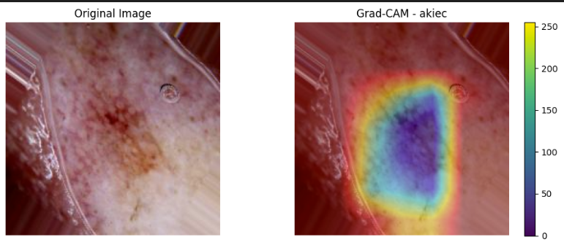
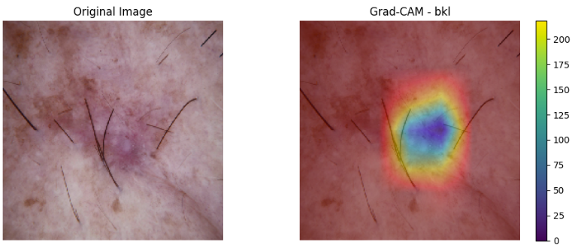
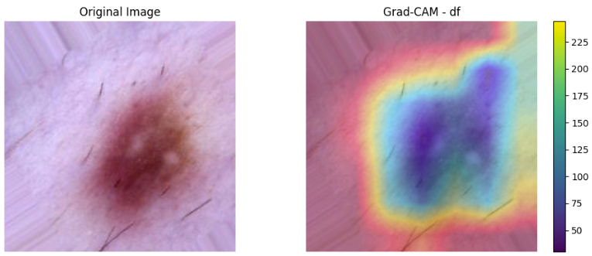
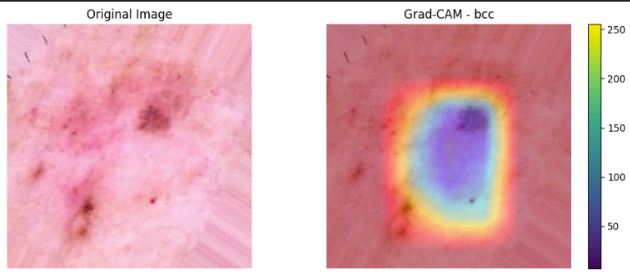
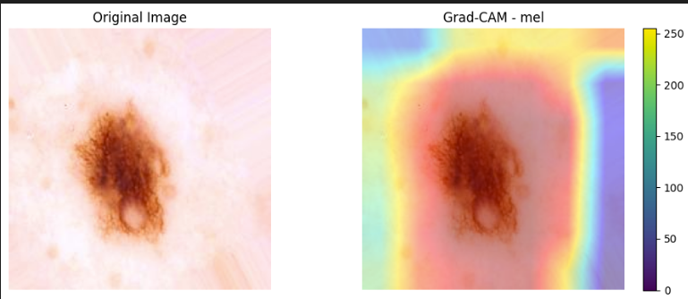
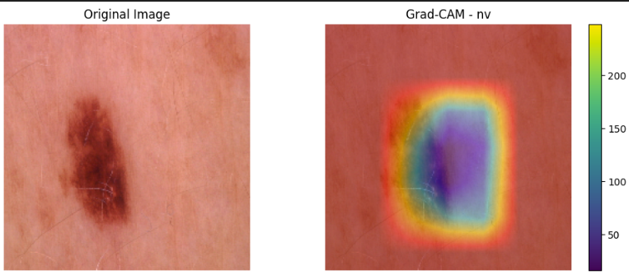
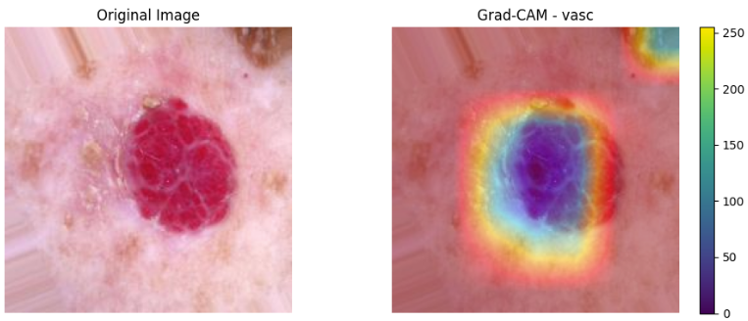
Grad-Cam Visualizations

Slide 19
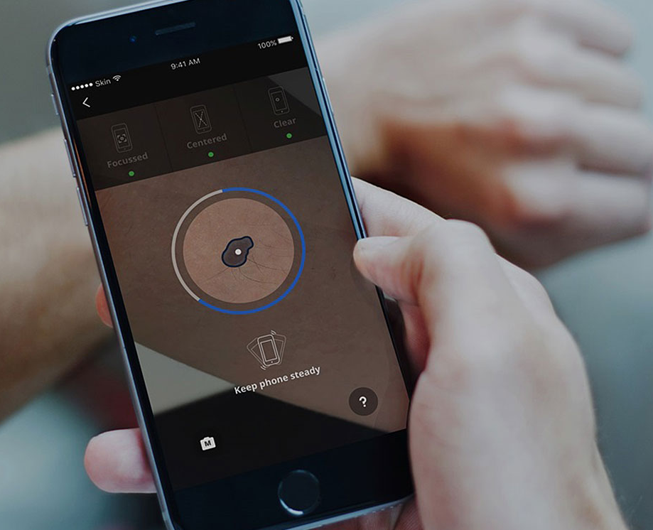
Future Work
Hair and Artifact Removal
Preprocess images to remove occlusions like hair and ruler marks using traditional image processing or deep learning-based segmentation.
This can improve feature clarity and help the model focus on lesion-specific patterns.
Advanced Handling of Minority Classes
Further enhance underperforming classes like MEL and DF using techniques such as:
Focal Loss to prioritize hard-to-classify samples.
GAN-based data generation for synthetic sample creation.
Class-wise threshold tuning for better precision-recall balance.
Notes:
This work contributes a modular, interpretable model for skin lesion diagnosis. It strikes a balance between clinical trust and technical performance, and the visual analysis pipeline further strengthens its potential for medical deployment.
In conclusion, our model advances deep learning for dermatology by combining accuracy and interpretability. Future work will focus on real-world integration, use of patient data, and exploration of newer model architectures like transformers for even better generalization.

Slide 20
Conclusion
Effective Hybrid Model Successfully integrated Soft Attention with ResNet50, achieving 92.6% accuracy and improved interpretability through attention maps and Grad-CAM.
Class Imbalance Addressed Automated class weighting and augmentation significantly enhanced performance for rare classes like DF/VASC.
Clinical Relevance Attention maps align with diagnostic features, validating the model’s decision-making process for dermatologists.
Enhanced Performance with Data Augmentation Strategic augmentation (rotations, flips, brightness) of minority classes (MEL/DF/AKIEC) with 8,000+ synthetic samples significantly reduced class imbalance and improved model robustness.

Slide 21
End of Contents
Notes:
Welcome everyone. Today, we’re presenting our deep learning research project: Deep-Lesion Scan. This study aims to enhance skin lesion classification by integrating a Soft Attention mechanism into the ResNet50 architecture to improve both accuracy and interpretability.

